Slide 1
Capstone Project
HOTEL BOOKING ANALYSIS (EDA) BISWAJIT GOCHHAYAT

Slide 2
CONTENT
Introduction to EDA
Data summary
Define problem statement
EDA
Recommendation

Slide 3
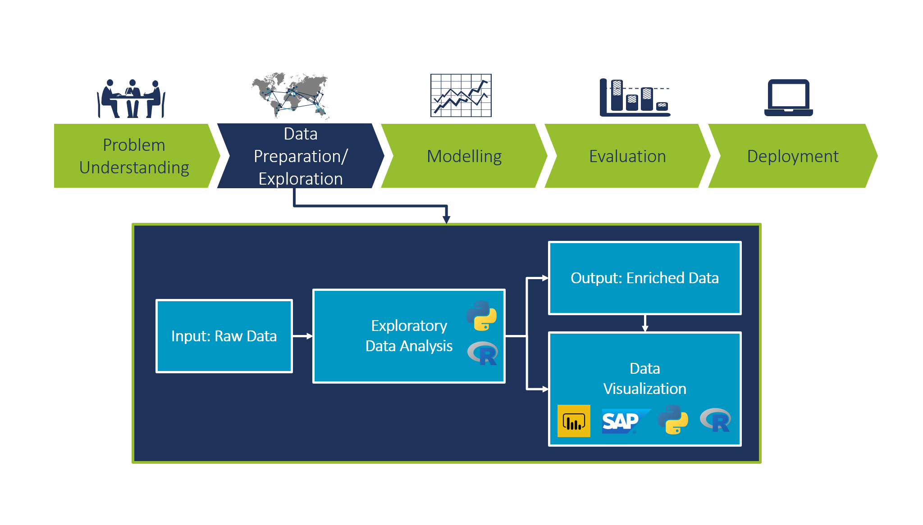
Introduction to EDA
EDA :
Exploratory Data Analysis, or EDA, is an important step in any Data Analysis or Data Science project. EDA is the process of investigating the dataset to discover patterns, and anomalies (outliers), and form hypotheses based on our understanding of the dataset.
EDA is generally classified into two
methods, i.e.
1) graphical analysis and
2)non-graphical analysis
.

Slide 4
The primary motive of EDA is to :
Examine the data distribution
Handling missing values of the dataset(a most common issue with every dataset)
Handling the outliers
Removing duplicate data
Encoding the categorical variables
Normalizing and Scaling

Slide 5
Data Summary :
hotel: hotel type(H1 = Resort Hotel or H2 = City Hotel)
Is canceled: Value indicating if the booking was canceled (1) or not (0)
Lead time: Number of days that elapsed between the entering date of the booking
Arrival date year: Year of arrival date
Arrival date month: Month of arrival date
Arrival date week number: Week number of year for arrival date
Arrival date day of the month: Day of arrival date
Stays in weekend nights: Number of weekend nights (Saturday or Sunday) the guest stayed or booked to stay at the hotel
Stays in weeknights: Number of weeknights (Monday to Friday) the guest stayed or booked to stay at the hotel.
babies: Number of babies ( The word 'baby' means any child from birth to age 4,)
meal: Type of meal booked. Categories are presented in standard hospitality
country: Country of origin.
Distribution channel: Booking distribution channel. The term “TA” means “Travel Agents” and “TO” means “Tour Operators”.

Slide 6
Data summary :
is repeated guest: Value indicating if the booking name was from a repeated guest (1) or not (0)
Previous cancel at bookingions: Number of previous bookings that were cancelled by the customer prior to the current
Reserved room type: Code of room type reserved. Code is presented instead of designation for anonymity reasons.
agent: ID of the travel agency that made the booking
company: ID of the company/entity that made the booking or responsible for paying the booking. ID is presented instead of designation for anonymity reasons.
days in waiting list: Number of days the booking was in the waiting list before it was confirmed to the customer.
days in waiting list: Number of days the booking was in the waiting list before it was confirmed to the customer.
adr: Average Daily Rate as defined by dividing the sum of all lodging transactions by the total number of staying nights.

Slide 7
Required car parking spaces: Number of car parking spaces required by the customer
Vtotal of special requests: Number of special requests made by the customer (e.g. twin bed or high floor)
Reservation status: Reservation the last status, assuming one of three categories: Canceled – booking was canceled by the customer; Check-Out – customer has * checked in but already departed; No-Show – the customer did not check in and did inform the hotel of the reason why.
Reservation status date: Date at which the last status was set. This variable can be used in conjunction with the Reservation Status to understand when was the booking canceled or when did the customer checked out of the hotel.

Slide 8
Define Problem Statement :
Which hotel has the most preferable hotel and find the percentage of cancelation and non-cancellation of each hotel?
Which hotel has the most repeated guests?
Which hotel has more number of stays on a weekend and also the maximum number of stays on weeknights?
In which month the reservation is peak or lowest, and what is the busiest months for hotel and resorts?
In which country does the most number of guests come and Which country makes the most hotel booking cancelation?
Is the parking space most required?
Which is the most preferable meal?
Which type of customer is more likely to cancel the booking?

Slide 9
Define problem statement :
12) What is the monthly reservation by market segment?
13)Which distribution channel has heigh cancellation?
14) Which are the most reserved room type?
15)How many visitors get the room that they reserved?

Slide 10
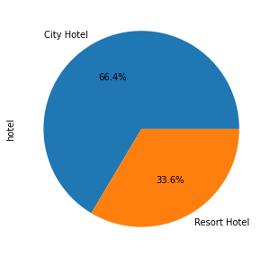
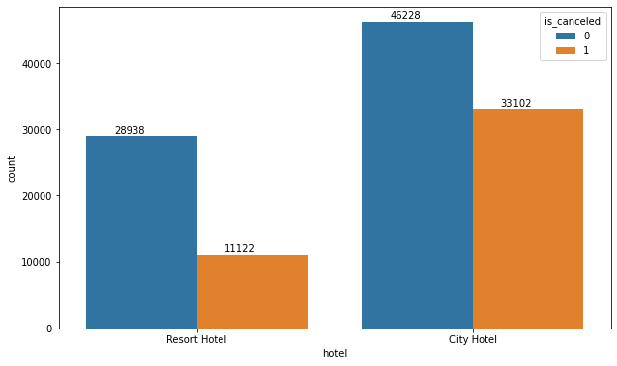
1. Which hotel has the most preferable hotel and find the percentage of cancelation and non-cancellation of each hotel?
Observation: Out of all bookings 66.4 % of bookings are for a city hotel and the cancelation rate is also high and 33.6 % of bookings are for resort hotels and the cancelation rate is low as compared to city hotels.

Slide 11
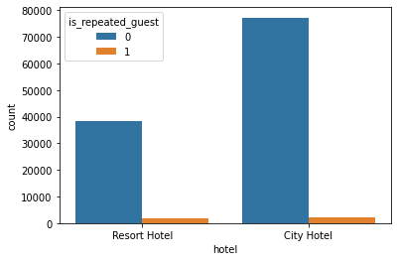
Which hotel has the most repeated guests?
Both hotels have a very small number of booking from old customers.
In City Hotel 2032 (2.56%) and in Resort Hotel 1778 (4.43%)guests visited more than once which shows the overall service of the hotels was good.
.

Slide 12
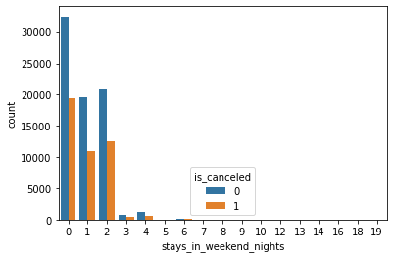
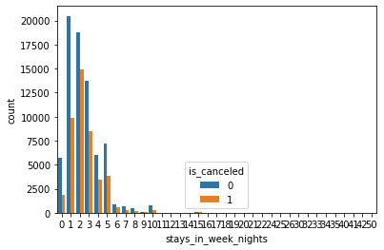
Which hotel has more number of stays on a weekend and also the maximum number of stays on weeknights?

Slide 13
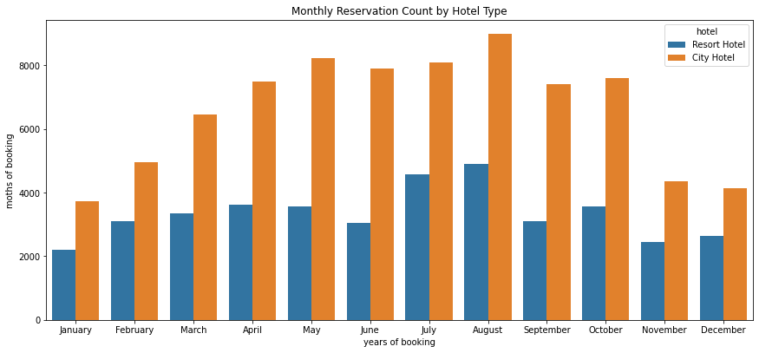
In which month the reservation is peak or lowest, and what is the busiest months for hotel and resorts?
In the case of city hotels, months with high bookings (May, June, September, October) also witnessed more cancellations. Guest numbers for the Resort hotel go down slightly from June to September through variations in bookings and cancellations are less in the case of the resort hotel. Both hotels have the fewest guests during the winter.

Slide 14
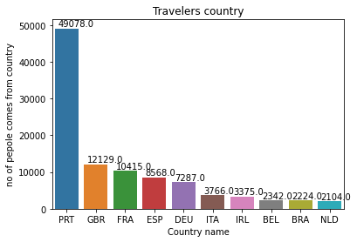
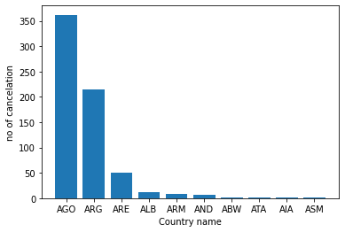
In which country does the most number of guests come and Which country makes the most hotel booking cancelation?
Observation: Most of the foreigners are coming from Portugal.
Observation: AGO (Angola) ,ARG(Argentina) makes the most cancelation hotels.

Slide 15
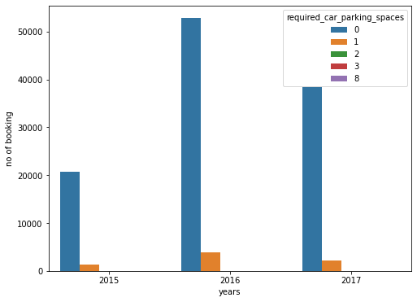
Is the parking space most required?
Observation: around 90% of reservations do not require a parking space.

Slide 16
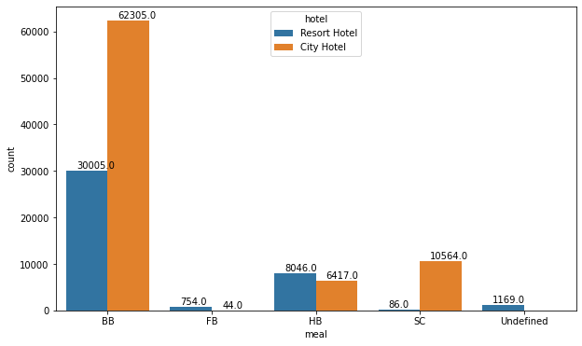
Which is the most preferable meal?
The categories in the meal column mean:
BB: Bed & Breakfast
HB:: Half board (breakfast and one other * meal – usually dinner)
FB: Full board (breakfast, lunch, and dinner)
Undefined/SC: no meal package
Bed & Breakfast is the most common option among the customers in every hotel type.

Slide 17
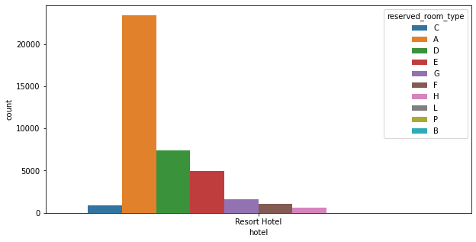
Which are the most reserved room type?
observation: The "A" type room is most liked by people and the "D" type in both hotels.

Slide 18
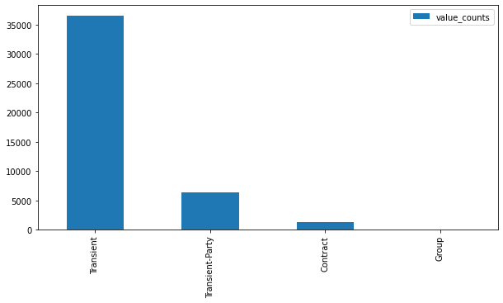
Which type of customer is more likely to cancel the booking?
OBSERVATION:Transient customer type are more likely to cancel the booking more than the other types

Slide 19
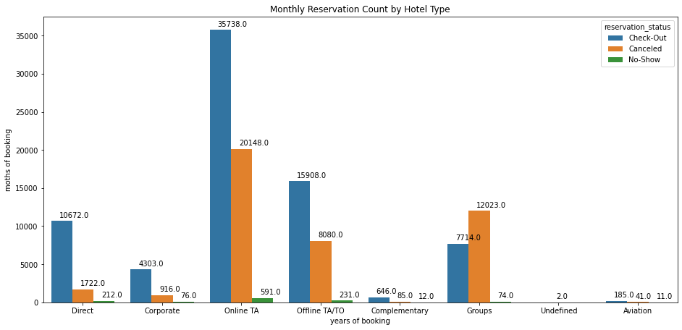
What is the monthly reservation by market segment?
OBSERVATION: Online TA, Groups make the most cancellation of hotels as compared to other market segment categories. Indirect bookings through online and offline travel agents are higher compared to direct bookings and the same is the case with group bookings which are also high.

Slide 20
Recommendation:
Hotels should charge some booking deposit for the following types of people:-
i)People who have a lead time greater than 100 days
ii)Customers with the previous cancellation
iii)Large group bookings
Resources management
i)Weekends are the busiest
ii) people order breakfast
iii) Nov, Dec, Jan, Feb, and March are the least busy months

